Slide 1
BatLit.org - Mobilizing Bat Literature
through existing Collaborations, platforms, and open source tools Jorrit Poelen (UC Santa Barbara, Ronin Institute) Aja C. Sherman (Bat Eco-Interactions Project) Anna Willoughby (University of Georgia, Athens, GA, US) Donat Agosti (Plazi) Nancy B. Simmons (American Museum of Natural History) Nathan S. Upham (Arizona State University) Cullen Geiselman (Bat Eco-Interactions Project)

Slide 2
Guiding Questions
How do you access/reuse literature collection?
How do you organize your literature collection?
How do you share your literature collection?

Slide 3
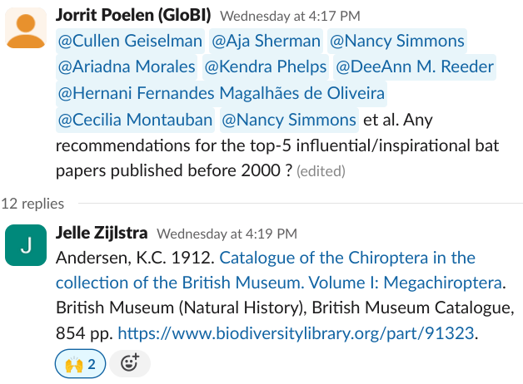

Slide 4
Andersen, 1912: An Influential Bat Work
Andersen, K.C. 1912. Catalogue of the Chiroptera in the collection of the British Museum. Volume I: Megachiroptera. British Museum (Natural History), British Museum Catalogue, 854 pp. https://www.biodiversitylibrary.org/part/91323.

Slide 5
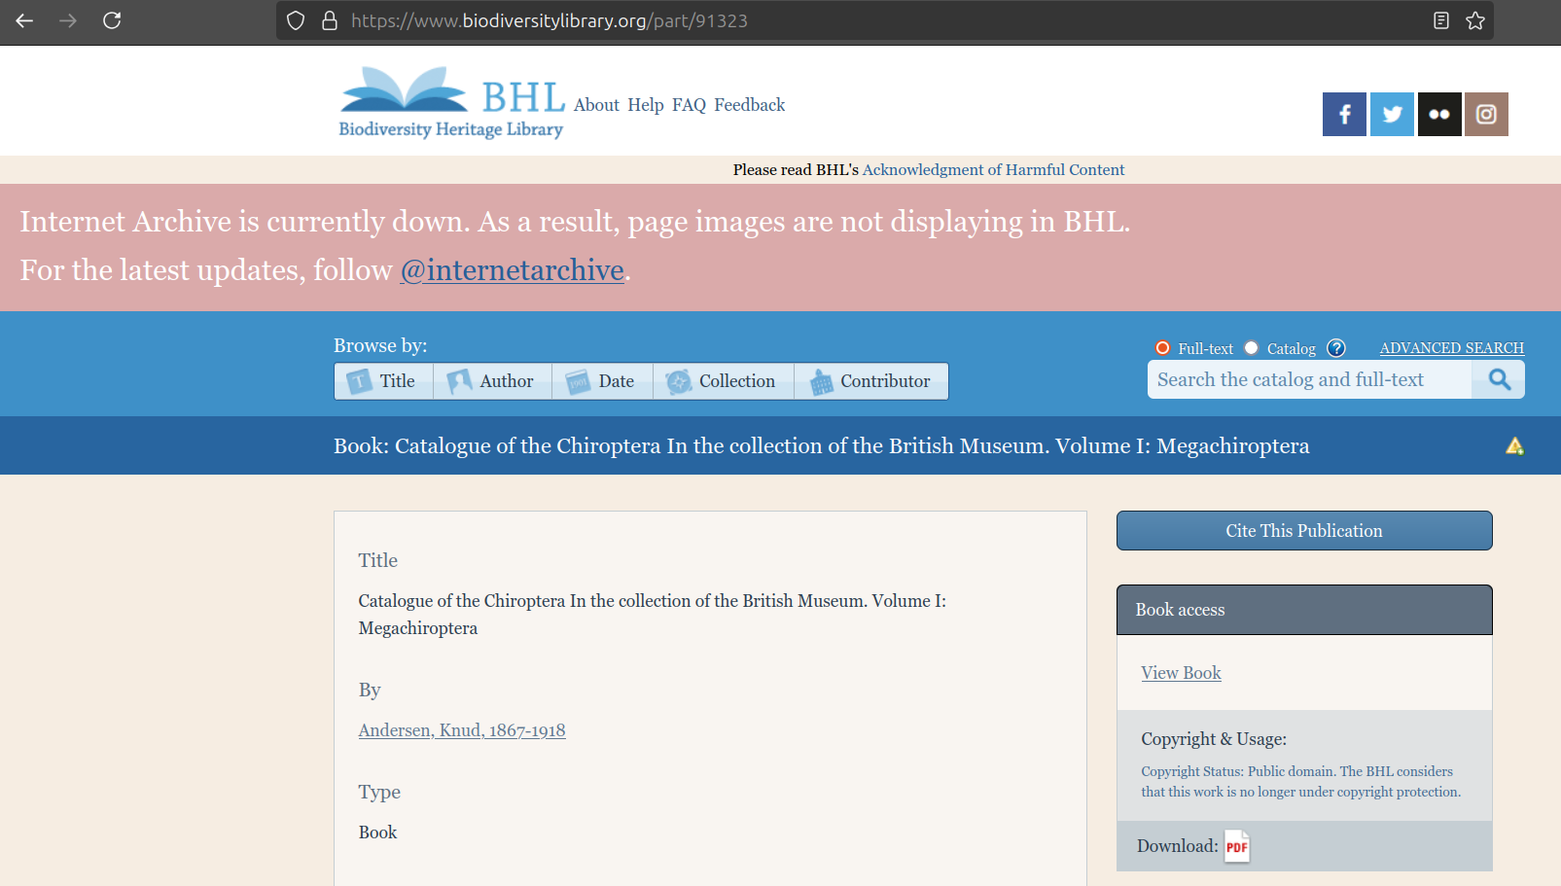
Finding Andersen, 1912
Internet Archive Down Banner on Biodiversity Heritage Library. Accessed at https://www.biodiversitylibrary.org/part/91323 on 2024-10-16.

Slide 6
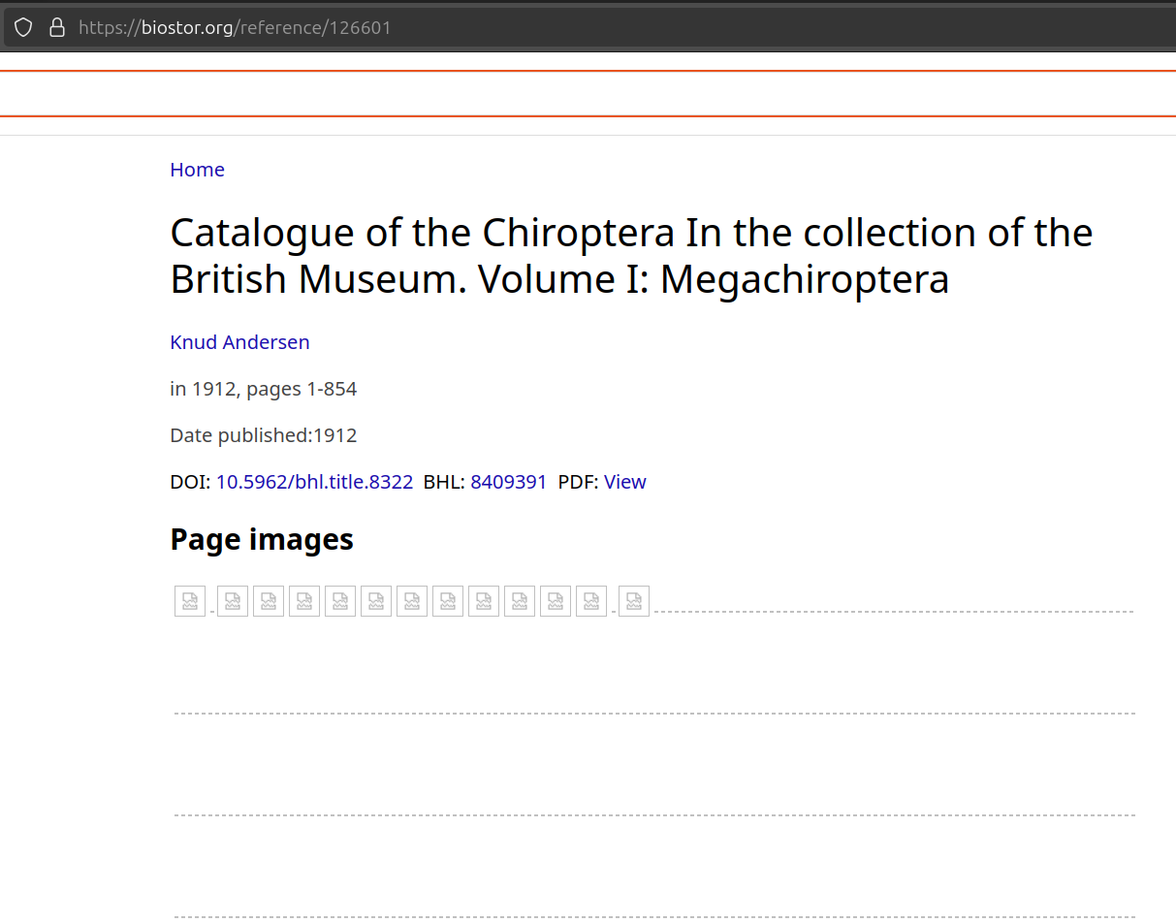
Finding Andersen, 1912
Andersen 1912 as seen at https://biostor.org/reference/126601 on 2024-10-22.

Slide 7
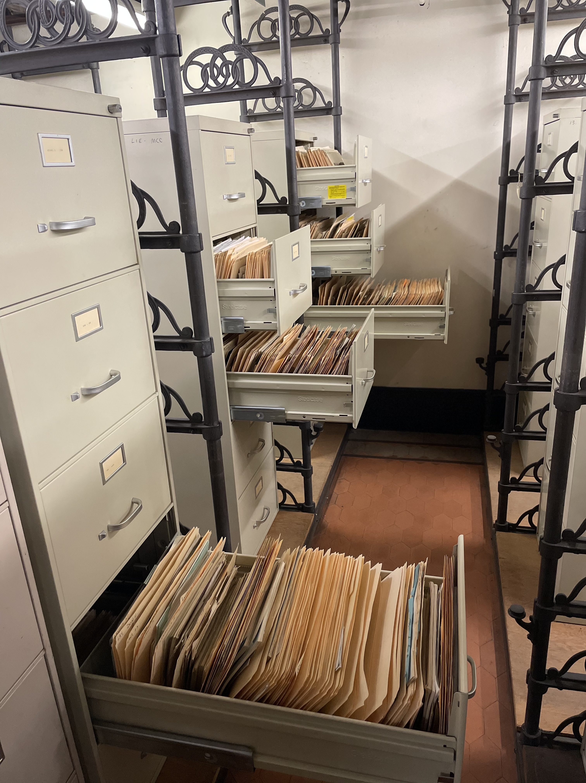
Finding Andersen, 1912
Like this?
AMNH Department of Mammalogy Library. 2024-10-03. Photo by Nancy Simmons

Slide 8
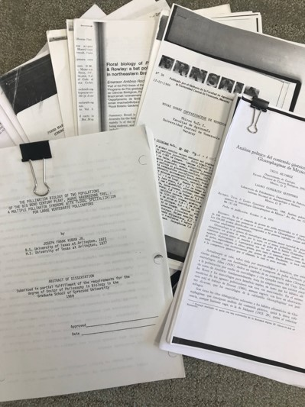
Finding Anderson, 1912
Or, like this?
Bat Papers on Cullen’s Desk. 2024-10-03. Photo by Cullen Geiselman

Slide 9
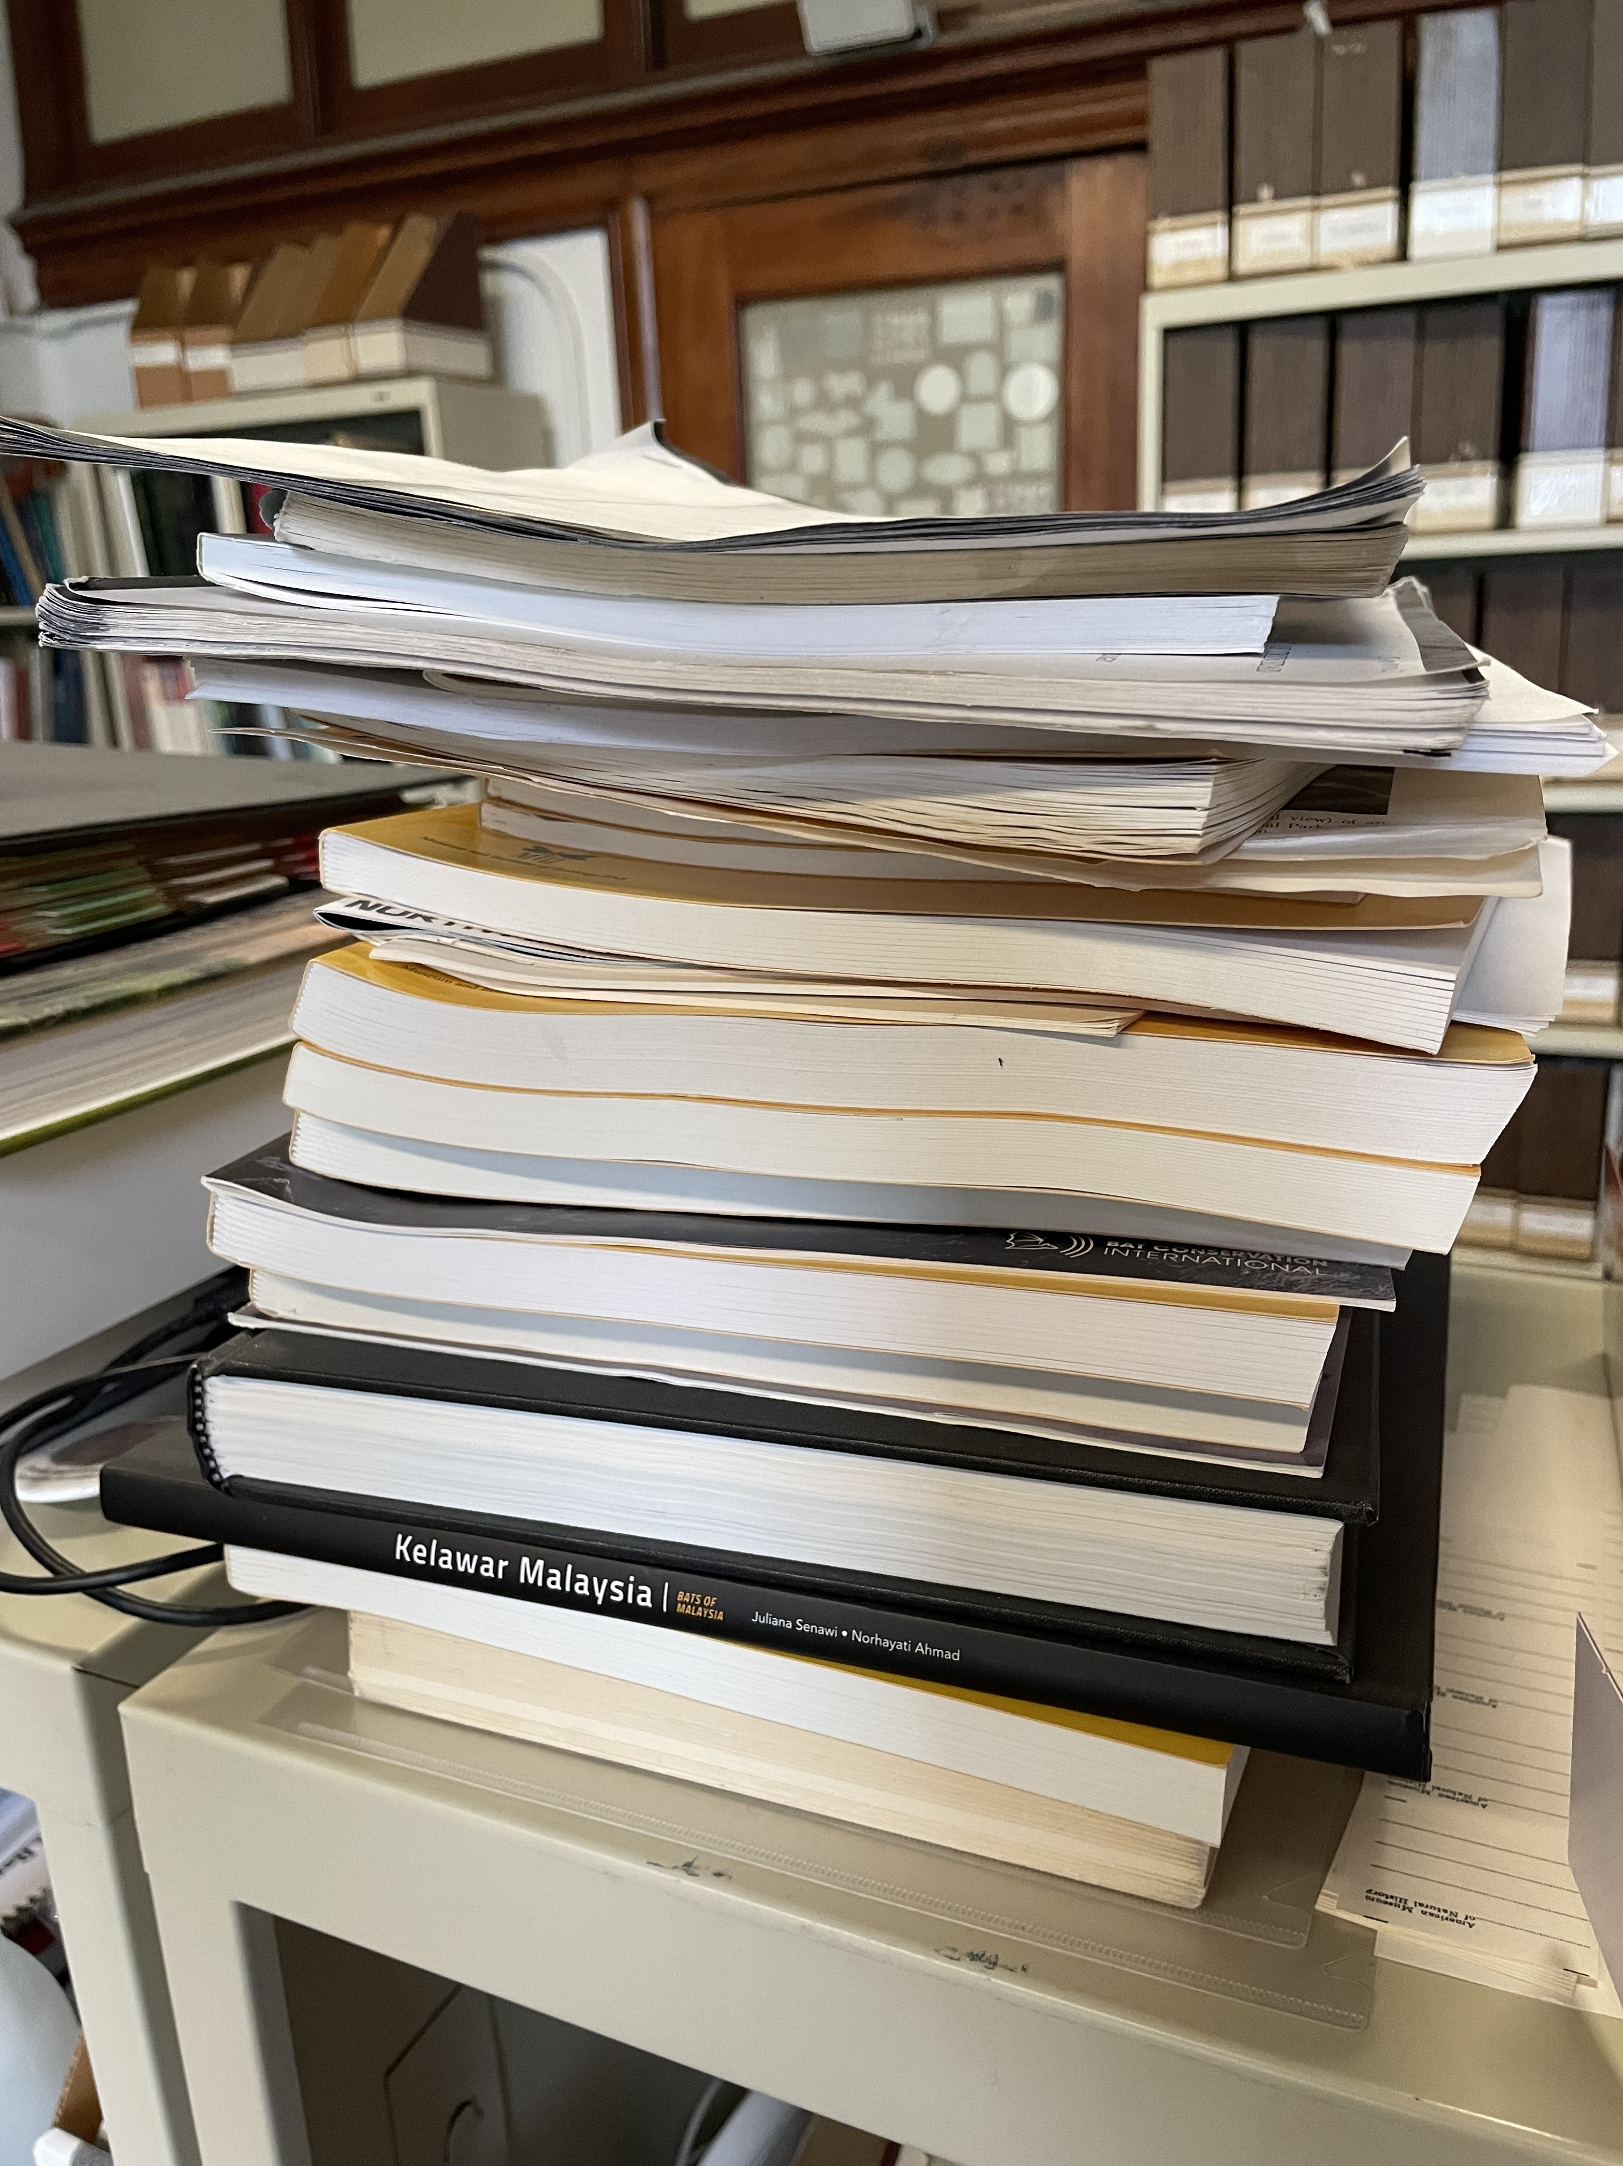
Finding Anderson, 1912
Or perhaps like this?
Pile of Paper in Nancy’s Office. 2024-10-03. Photo By Nancy Simmons

Slide 10
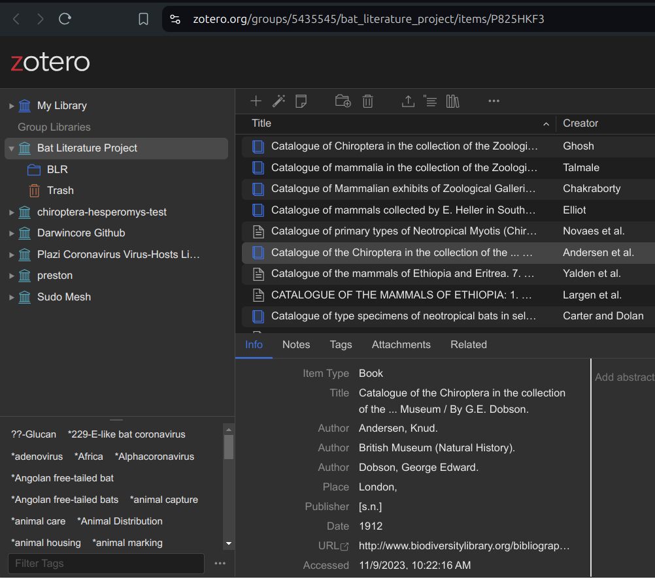
Finding Anderson, 1912
Members only Zotero record in the Bat Literature Project as accessed at https://www.zotero.org/groups/5435545/bat_literature_project/items/P825HKF3 on 2024-10-22

Slide 11
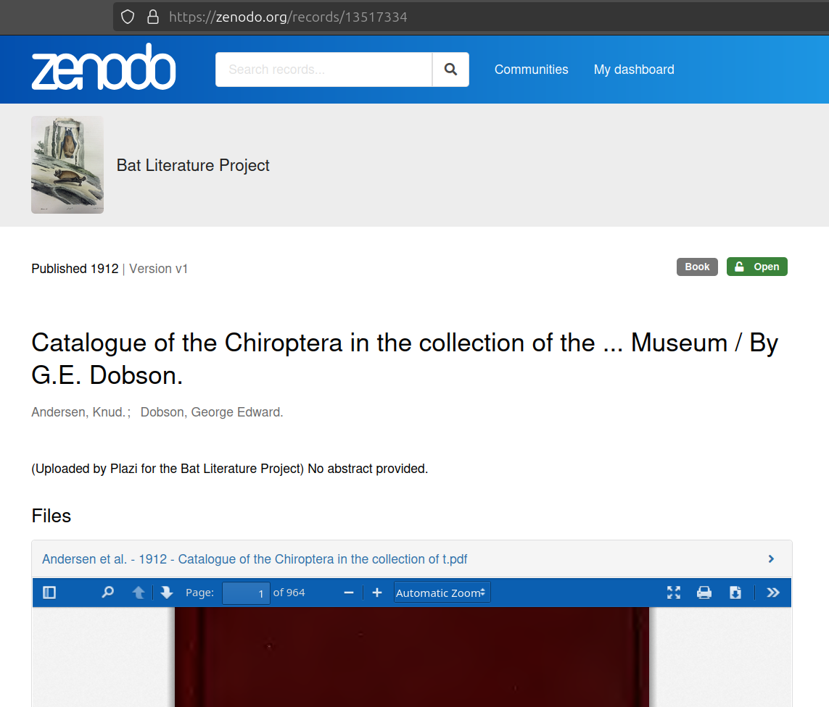
Finding Andersen, 1912
Digital Copy of Andersen 1912 as seen at https://zenodo.org/records/13517334 on 2024-10-22

Slide 12
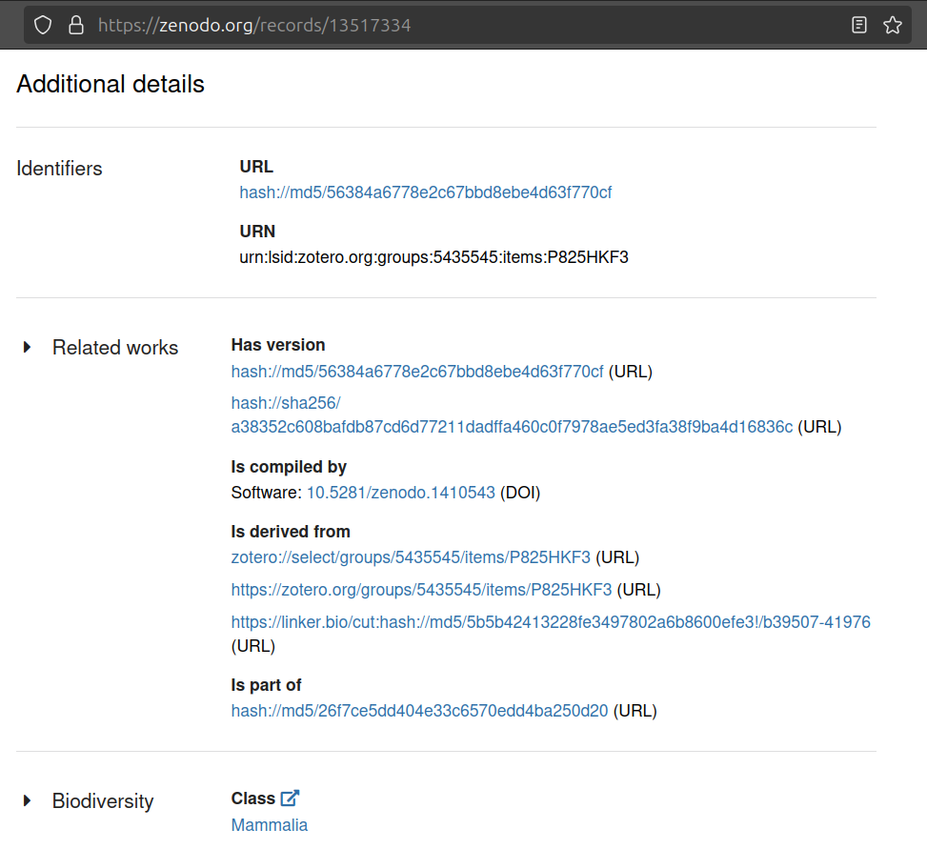
Finding Andersen, 1912
Identifiers associated with Digital Copy of Anderson 1912 as seen at https://zenodo.org/records/13517334 on 2024-10-22

Slide 13
Finding Anderson, 1912
So, some webpage
… at https://zenodo.org/records/13517334 …
… as accessed on 2024-10-22
… claims that Anderson, 1912
… is associated with a digital fingerprint
… <hash://md5/56384a6778e2c67bbd8ebe4d63f770cf>
… that uniquely identifies a “physical” digital copy
… of the seminal Andersen, 1912 work.

Slide 14
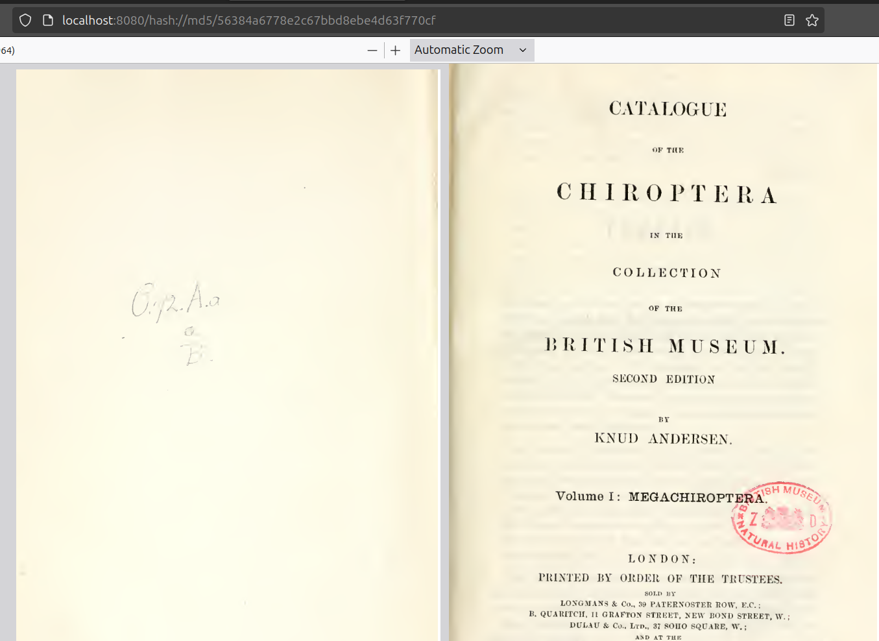
Found Andersen, 1912 at 30,000 ft
(screenshot made of Jorrit’s laptop screen at 30,000 ft on UA6135 IAH to GDL on 2024-10-22 using: Sherman, A.C. et al 2024. BatLit.org v0.6 hash://md5/db73e659e8cf16ef50e82bb5e72ae97b)

Slide 15
Found Andersen, 1912!
Note to self: next time, add a digital content fingerprint to identify the exact digital copy of Anderson, 1912 you’d like to reference.

Slide 16
Citing Andersen, 1912 pre-Internet
Andersen, K.C. 1912. Catalogue of the Chiroptera in the collection of the British Museum. Volume I: Megachiroptera. British Museum (Natural History), British Museum Catalogue, 854 pp.

Slide 17
Citing Andersen, 1912 in the Age of the Internet
(with internet locations)
Andersen, K.C. 1912. Catalogue of the Chiroptera in the collection of the British Museum. Volume I: Megachiroptera. British Museum (Natural History), British Museum Catalogue, 854 pp. https://www.biodiversitylibrary.org/part/91323 https://doi.org/10.5962/bhl.title.8322

Slide 18
Citing Andersen, 1912: Beyond the Internet
(with internet locations and non-internet identifiers)
Andersen, K.C. 1912. Catalogue of the Chiroptera in the collection of the British Museum. Volume I: Megachiroptera. British Museum (Natural History), British Museum Catalogue, 854 pp. https://www.biodiversitylibrary.org/part/91323 https://doi.org/10.5962/bhl.title.8322 hash://md5/56384a6778e2c67bbd8ebe4d63f770cf ¹

Slide 19
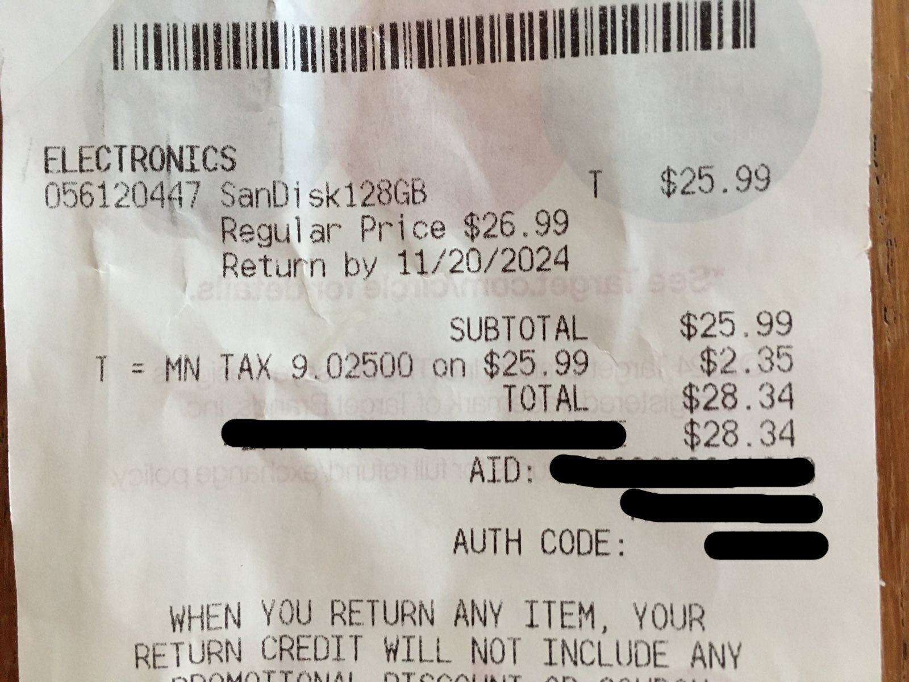
How Was Jorrit Able to Access This Paper at 30,000 ft?
Jorrit bought a 128GB SD Card for ~$25 USD at the Target on 2500 E Lake St, Minneapolis, Minnesota before NASBR 2024

Slide 20
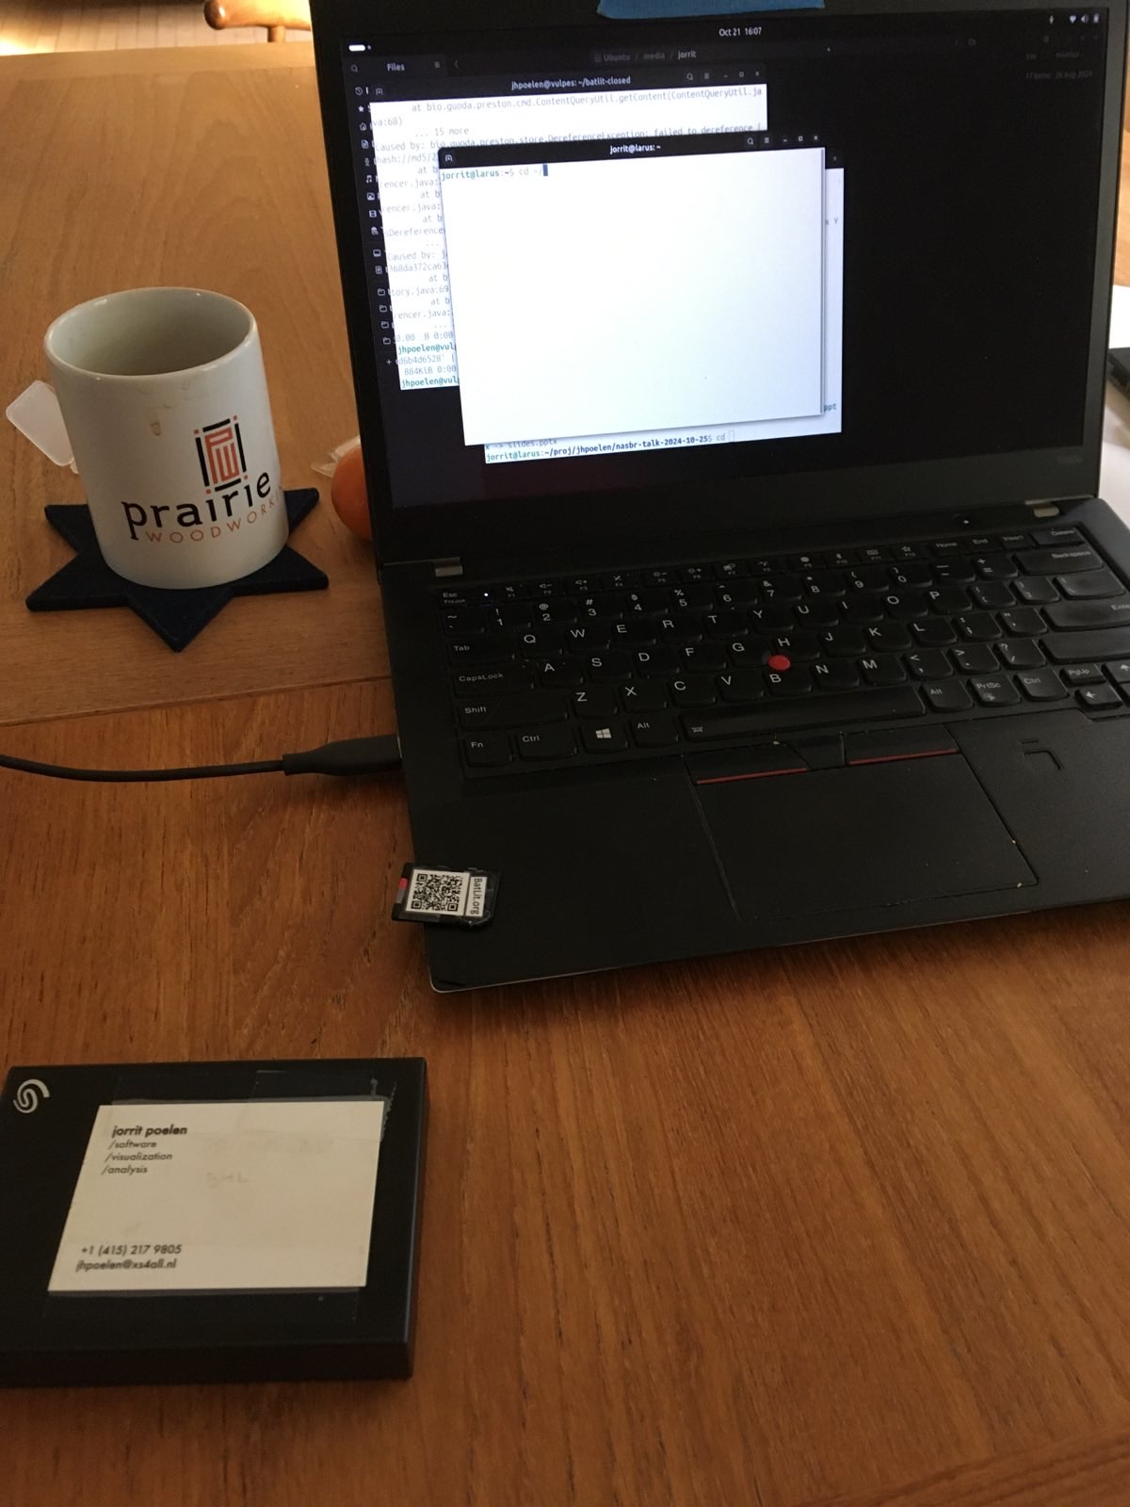
How Was Jorrit Able to Access This Paper at 30,000 ft?
Jorrit copying BatLit v0.6 hash://md5/db73e659e8cf16ef50e82bb5e72ae97b on 2024-10-21

Slide 21
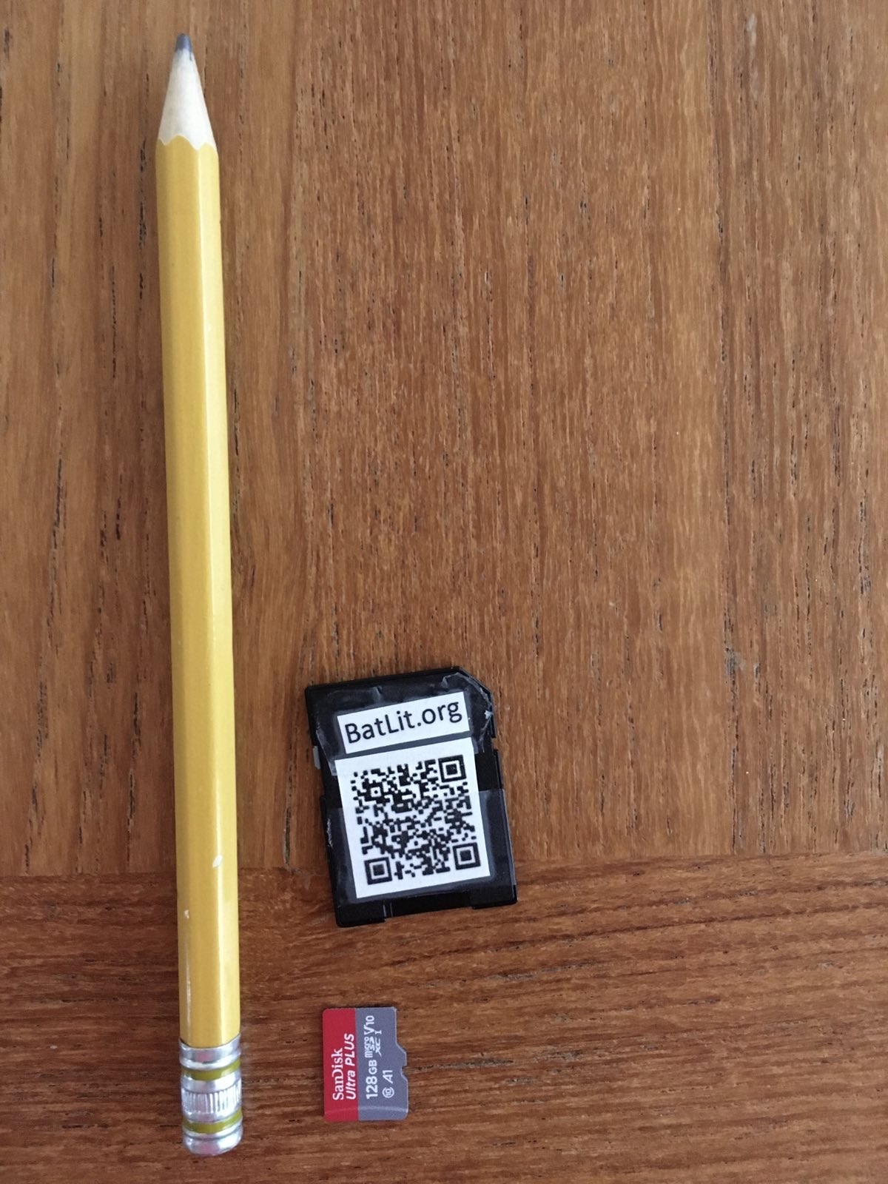
How Was Jorrit Able to Access This Paper at 30,000 ft?
SD Card carrying > 400k pages of bat literature contained in BatLit v0.6 hash://md5/db73e659e8cf16ef50e82bb5e72ae97b on 2024-10-21

Slide 22
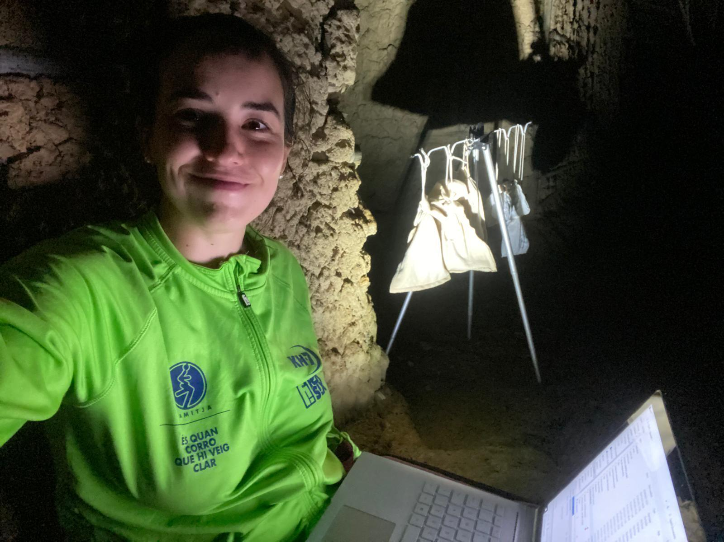
Wishing you had 20k bat papers at your fingertips?
Cecilia Montauban catching bats in Ghana while writing a Bat Conservation International student scholarship application Ghana in October 2021

Slide 23
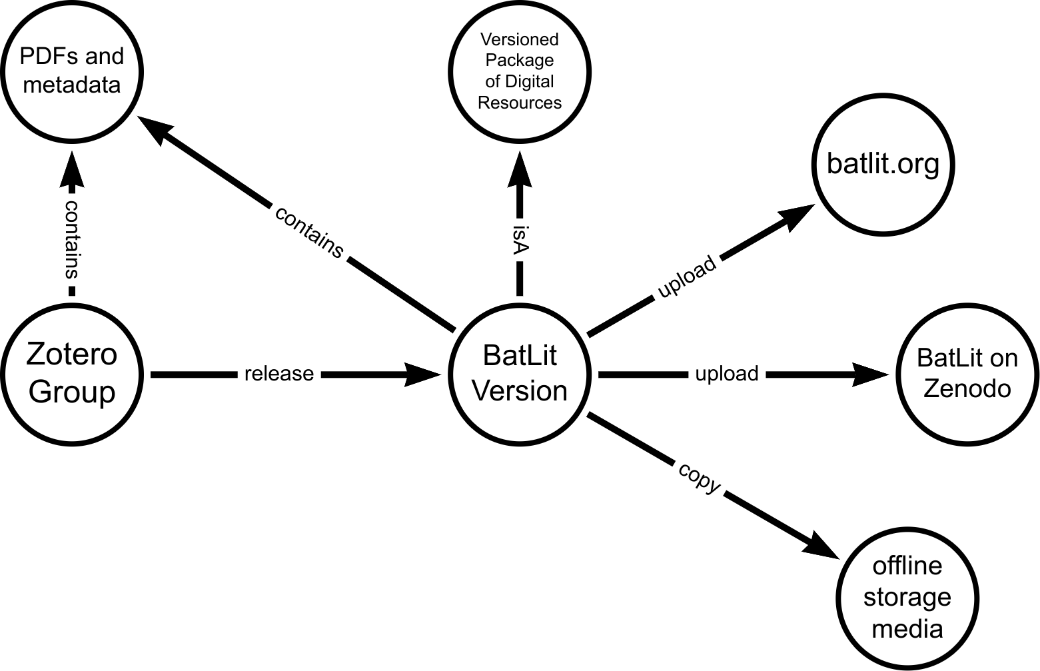
BatLit Bits and Pieces
Zotero is used for managing a collection of literature references. Versioned snapshots of this collection are securely packaged in a BatLit version. This version is then mobilized using a website, the Zenodo batlit community, and on offline storage media.

Slide 24
BatLit Versions
version | date | size | # pages | # references | fingerprint
v0.6 | 2024-09-19 | 44.7GiB | 427,105 | 19,038 | hash://md5/db73e659e8cf16ef50e82bb5e72ae97b
v0.5 | 2024-08-16 | 50.9 GiB |  | 20,145 | hash://md5/26f7ce5dd404e33c6570edd4ba250d20
… | … | … | … | …
v0.1 | 2024-04-26 | 7.9 GiB |  | 2,929 | hash://sha256/6ba3d79cf1fd6349012cb4e527b6727b3e41e140489fa9c02f132e2cdd88d189

Slide 25
How Was Jorrit Able to Access Andersen, 1912?
Through Work of CETAF/GBatNet Eco-Interactions working group activities spanning 4.5 years in which:
goals were identified
(G1) make bat interaction data digitally accessible,
(G2) align bat taxonomic names to uncover their meaning, and
(G3) provide open-access to bat literature.
Plazi provided a legal framework via their Biodiversity Literature Repository ².
BatBase ³ provided curatorial support.
Jorrit reused open source software ⁴ to track, package and version bat literature metadata and their pdfs.
Researchers like you shared their literature collections.

Slide 26
Next Steps
Further develop governance model to help sustain BatLit.
Improve BatLit depth, mobility, and access for the benefit of the bat research community.
Use BatLit as a digital foundation for associated projects.

Slide 27
Want to know more?
Visit https://batlit.org, or chat/reach out to members of the GBatNet Eco-Interactions working group (in no particular order):
Aja Sherman, Nancy Simmons, DeeAnn Reeder, Nathan Upham, Cullen Geiselman, Cecilia Montauban, Hernani Oliveira, Ariadna Morales, Jelle Zijlstra, Quentin Groom, Donat Agosti, Kendra Phelps, Anna Willoughby, or Jorrit Poelen.

Slide 28
Thank you / Acknowledgments
BatLit would not have been possible without the tremendous amount of work done by you, your fellow bat researchers, and those that proceeded us.

Slide 29
Guiding Questions
How do you access/reuse literature collection?
How do you organize your literature collection?
How do you share your literature collection?

Slide 30
Extra

Slide 31
BatLit Workflow
BatLit Workflow

Slide 32
BatLit Workflow Steps
Curator Adds Digital Copy to BatLit Project on Zotero ⁵
Periodically, Archivist takes a snapshot of all Zotero records in BatLit, including bibliographic metadata and the “physical” digital copy (pdf).
Archivist puts the snapshots in a signed digital archive (box) and signs the provenance logs
Signed Digital Archive (or a batlit corpus version) is mobilized by translating and upload them to Zenodo, GitHub Pages, and various other network attached storage media
Signed Digital Archives is stored on offline enabled media (sd card, external hard disk)
Corpus is transmitted and discovered by students researchers
Corpus is reused by students and researchers, enabling both manual (e.g., reading, annotation) and automated (e.g., raw material for language model training) workflows
Reuse promotes improvement and further awareness

Slide 33
Accessing content associated with DOIs
Take 2.
turn on the internet (still there?)
open a web browser
load https://doi.org/10.5962/bhl.title.8322
and rely on a delicate and complex socio-technical network
inspect page
use mouse to click on a link that looks like a bug picture
download image and trust its authenticity

Slide 34
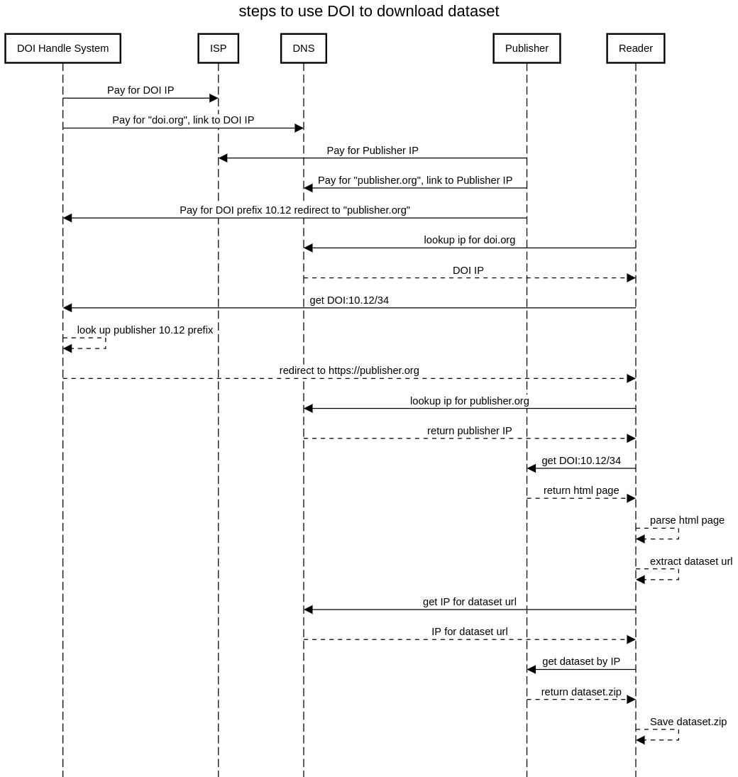
DOI Economics and Redirection
DOI Redirection Sequence Diagram

Slide 35
Internet Is Designed For Exchanging Information
The internet is a powerful tool for exchanging digital information. But the Internet’s contents changes constantly: websites are launched and taken down, webpages change, and content gets archived or lost.⁶

Slide 36
Internet Is Location-based
By design, a web address, or Uniform Resource Locator (URL), points to a specific internet location from which a resource, like a webpage, can be retrieved. However, a URL does not provide a way to verify that a retrieved webpage was the one we asked for. ⁷

Slide 37
Finding Content By Their Location Is … Tricky
Imagine using a URL-like reference to find a book at a library: instead of locating a book by what it is (e.g., title, author), you refer to a book by its location (e.g., third shelf on the second row next to the window). With this, a book becomes unfindable if moved to another shelf. And, if you do manage to find a book at the referenced location, how would you know you’ve found the book you are looking for? ⁸

Slide 38
Finding Content By Their (Summarized) Content Is … What Librarians Do
Instead of pointing to where books are located, librarians point to them using a bibliographic reference. For practical reasons, only a few identifying clues are included in such a reference (e.g., author, year of publication, title, and publisher). So, librarians refer to content by what it is, and knowing where it may be located is secondary. ⁹

Slide 39
Notes
1. Elliott M.J., Poelen, J.H. & Fortes, J.A.B. (2023) Signing data citations enables data verification and citation persistence. Sci Data. https://doi.org/10.1038/s41597-023-02230-y hash://sha256/f849c870565f608899f183ca261365dce9c9f1c5441b1c779e0db49df9c2a19d
2. https://plazi.org, https://zenodo.org/communities/biosyslit/records
3. Bat Eco-Interactions Project, https://batbase.org
4. https://github.com/bio-guoda/preston
5. https://www.zotero.org/groups/5435545/bat_literature_project
6. Jorrit Poelen. 2024. Unleashing Digital Knowledge Into The Future. Accessed on 2024-02-06 at https://linker.bio line:hash://sha256/8ac18eb75ff20d40d1d60bb6ad5a745eb528093d1ffbe373e3847c13146091eb!/L12
7. Jorrit Poelen. 2024. Unleashing Digital Knowledge Into The Future. Accessed on 2024-02-06 at https://linker.bio line:hash://sha256/8ac18eb75ff20d40d1d60bb6ad5a745eb528093d1ffbe373e3847c13146091eb!/L14
8. Jorrit Poelen. 2024. Unleashing Digital Knowledge Into The Future. Accessed on 2024-02-06 at https://linker.bio line:hash://sha256/8ac18eb75ff20d40d1d60bb6ad5a745eb528093d1ffbe373e3847c13146091eb!/L16
9. Jorrit Poelen. 2024. Unleashing Digital Knowledge Into The Future. Accessed on 2024-02-06 at https://linker.bio line:hash://sha256/8ac18eb75ff20d40d1d60bb6ad5a745eb528093d1ffbe373e3847c13146091eb!/L18

